Slide 1
Artificial Intelligence and COVID-19: Deep Learning Approaches for Diagnosis and Treatment
01
Guide name : Fanny May Joseph Name : Manisha kumari
Designation : Assistant Proffessor, MCA Register number : 38118219
S6 , MCA , CUCEK

Slide 2
TABLE OF CONTENTS
02
Abstract……………………....….03
Literature survey ……………….04-05
Proposed system ………………..06-07
Architecture ..................................08
Module description ……………. 09-10
Implementation…………………..11-12
Design……………………….…...13-15
Screen shots ……………………..16-27
Conclusion ....................................28
Future scope....................................29
Reference.........................................30

Slide 3
ABSTRACT
03
Several countries are under lockdown today because of the exponentially increasing number of COVID-19 cases. The one factor that can contain the virus, apart from an increase in hygiene and social distancing, is early diagnosis to effectively isolate carriers of the disease.
Limited availability of viral testing kits and the time-consuming nature of these tests is making radiology come to the forefront of diagnosis. The report given by them is turning out to be a key element in deciding the treatment.
COVID-19’s rate of transmission depends on our capacity to reliably identify infected patients, with a low percentage of false negatives. Timely detection of the disease enables the implementation of all supportive care required by the affected patients as well as isolation to prevent spread.
In COVID-19 scenario, covid infected people is easily captured through their property like fever, blowing nose ,head pain and body pain etc. but in this COVID 2.0 ,we found some of the people who have no any activity like this ,they also effected with covid .
we will do test to find the covid positive people but that test took 3 days or more time to find this .so for solving that solution we use xray and ct-scan report to find the effected people within one hour. Here we used more than 100 images dataset for postive and 100 plus images for covid negative and use that image to find covid positive patient. It will give 97% accuracy.

Slide 4
EXISTING SYSTEM
04
We used RT-PCR test for finding the covid positive but it is expensive, as it requires trained professionals, RNA extraction machines, and a laboratory.
It takes minimum four hours to get the RT-PCR test results , however, the results are available in one day due to time taken in collection and in the transportation of samples to the labs.If the testing lab is far from the place where the sample of the person has been collected, the test result may be available after 48 hours or more, in some cases.
On the other hand, the results of the rapid antigen test can come out in about half an hour but the accuracy is less than that of an RT PCR test.
The Indian Council of Medical Research had earlier quoted Rs.4,500 as the cost of PCR-Test for private laboratories in India, same as the pathology lab. At present, the price of an RT-PCR test to detect COVID-19 is somewhere between Rs. 2,200 and Rs.3,000 in India
Because of time consuming and cost ,most of people didn’t do their RT-PCR test .

Slide 5
DISADVANTAGE
05
Time consuming
Costly compare to proposed system
Requires trained professionals, RNA extraction machines, and a laboratory.

Slide 6
PROPOSED SYSTEM
06
AI approaches can be useful in eliminating disadvantages such as insufficient number of available RT-PCR test kits, test costs, and waiting time of test results.
It is simple, accurate, and fast AI models may be helpful to overcome this problem and provide timely assistance to patients.
The proposed model has an end-to-end architecture without using any feature extraction methods, and it requires raw chest X-ray images to return the diagnosis.
The models can be readily used in healthcare centers. There is no need to wait long hours for the radiologists to screen the images. Thus, healthcare workers and patient relatives can focus on isolation of suspicious cases so that treatment can begin.
The spread of the disease can be significantly reduced. The patients can seek a second opinion if they are diagnosed as positive by our system. Hence, waiting time can be significantly reduced, and it will alleviate clinician workload.

Slide 7
ADVANTAGES
07
Take less time compare to exisiting system
Less costly compare to exisiting system
More Accurate upto 97%
User Friendly

Slide 8
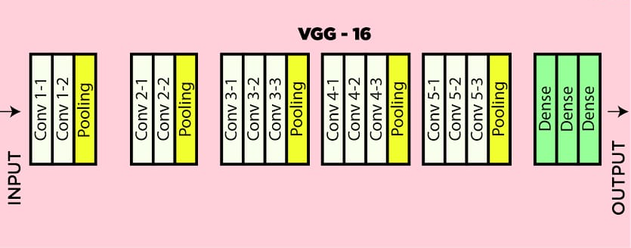
VGG16 ARCHITECTURE
08

Slide 9
MODULE DESCRIPTION
09
USER
DETECTION
USER
Guidance to Use
Upload X-Ray images
View X-ray report
Upload CT-Scan
View CT report
View Analysis

Slide 10
10
DETECTION
Collection chest X-ray or CT images of patient
Normalize the data(Images)
Resizing of images
Classifying the images
Evaluation
.

Slide 11
IMPLEMENTATION
11
HARDWARE REQUIREMENTS
System : Pentium V
Hard Disk : 40 GB.
Monitor : 15 VGA Colour.
Ram : 512 Mb.
SOFTWARE REQUIREMENTS
➢Operating system : Windows 10
➢ Coding Language : Python
Platform : Pycharm

Slide 12
12
LIBRARY REQUIREMENTS
flask
tensorflow
pillow
MODEL REQUIREMENT
VGG16 model
Convolutional neural network (CNN)

Slide 13
USE CASE DIAGRAM
DIAGRAMS
13
Artificial Intelligence and COVID-19: Deep Learning Approaches for Diagnosis and Treatment
See the guidelines
Upload images
Predict report
User
Analysis

Slide 14
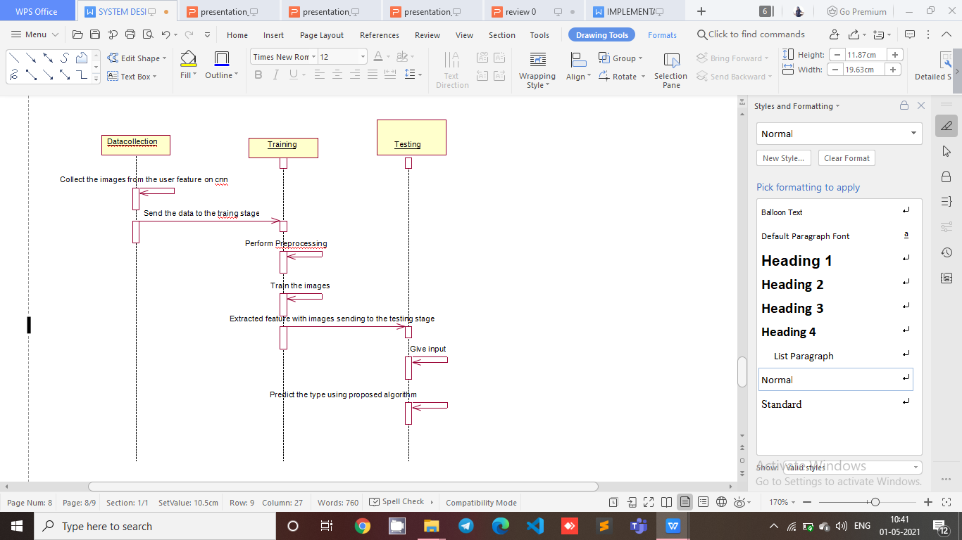
SEQUENCE DIAGRAM
14

Slide 15
ACTIVITY DIAGRAM
15
Input images
Preprocessing
Training
Prediction using proposed algorithm(cnn model)
Predicted Label As positive or negative

Slide 16

SCREENSHOTS
16
Main Page

Slide 17
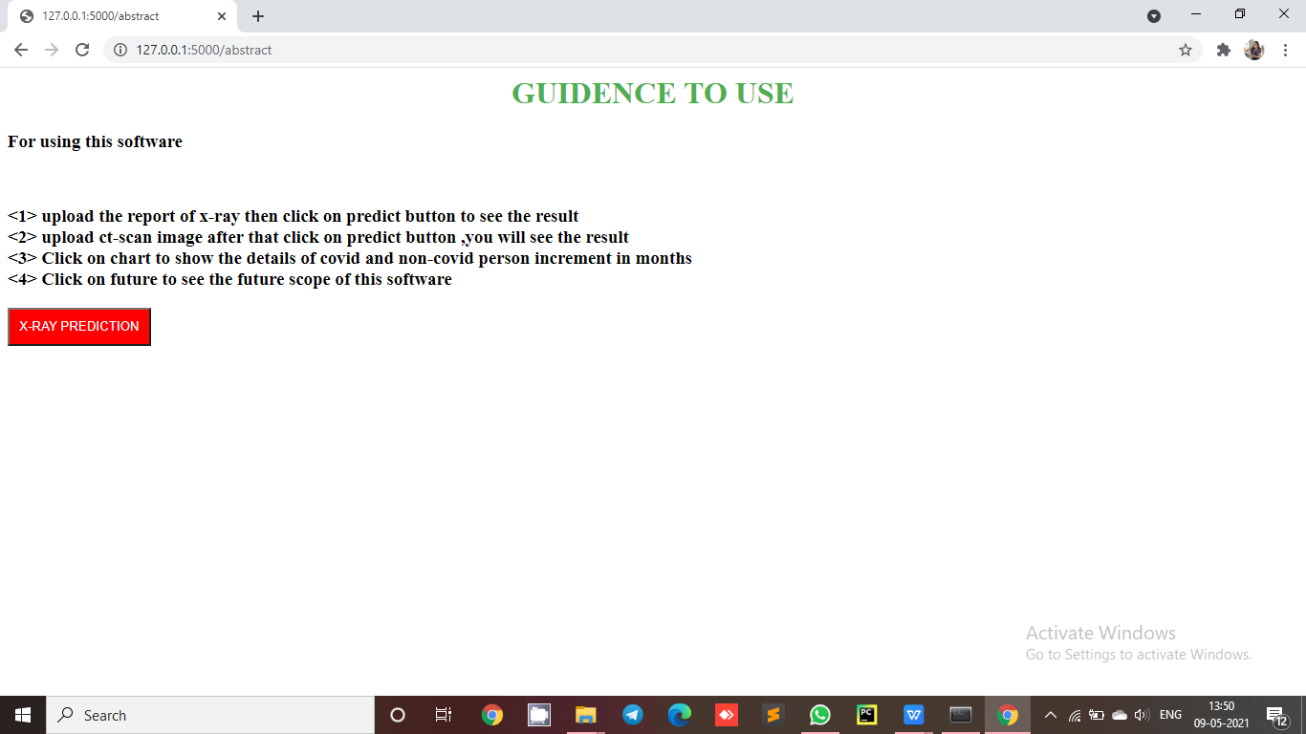
Guidance
17

Slide 18
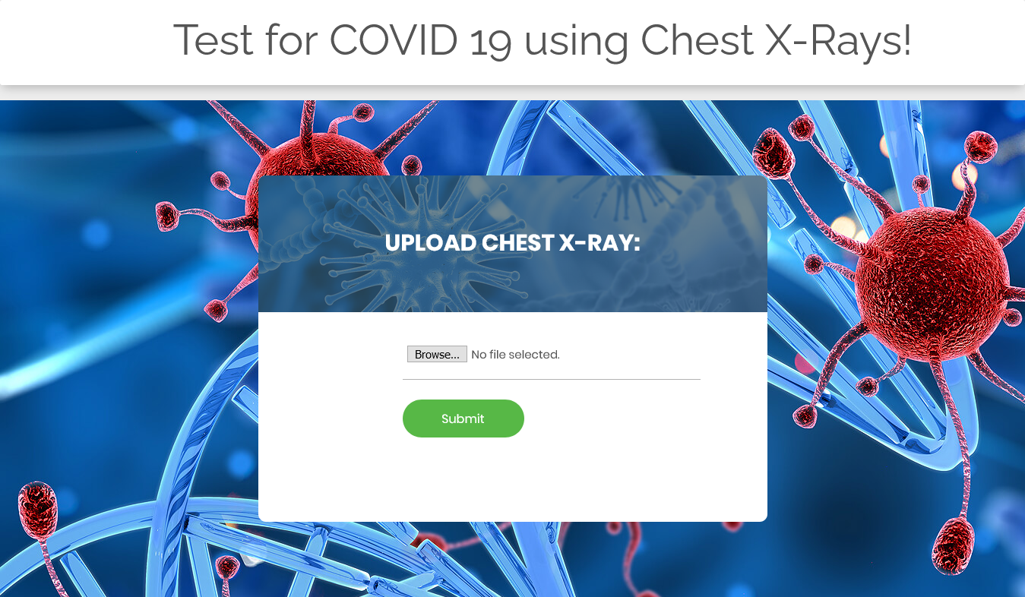
Chest x-ray
18

Slide 19
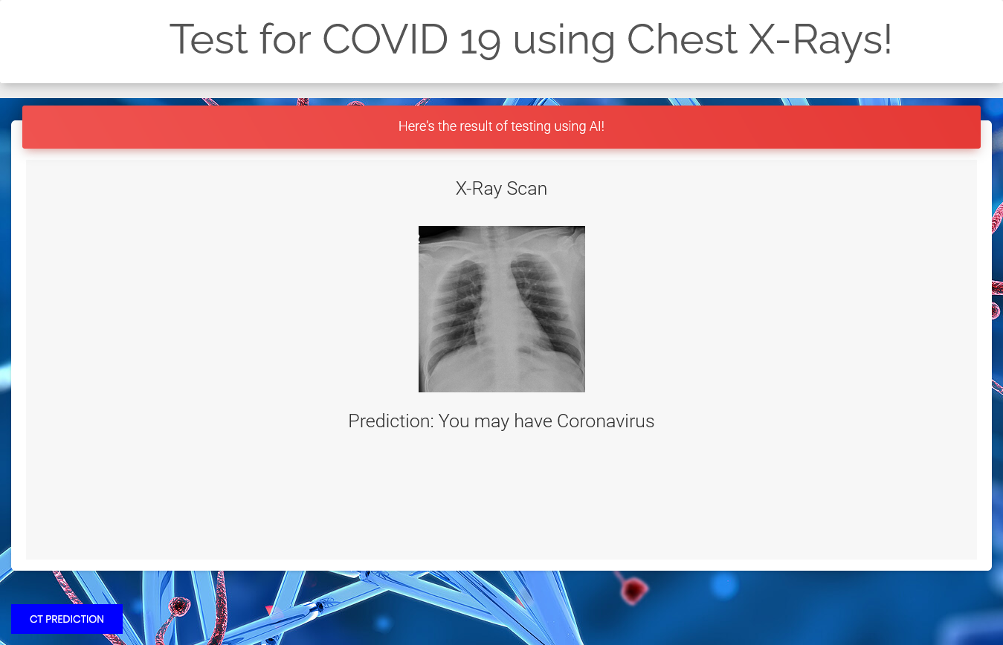
X-ray Report
19

Slide 20

Chest X-ray
20

Slide 21
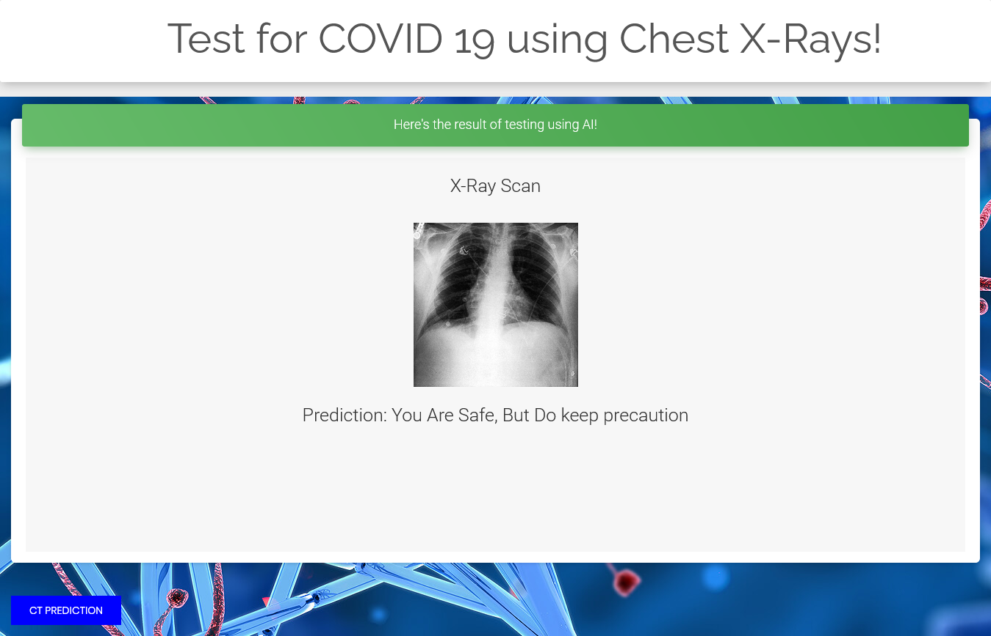
X-ray Report
21

Slide 22
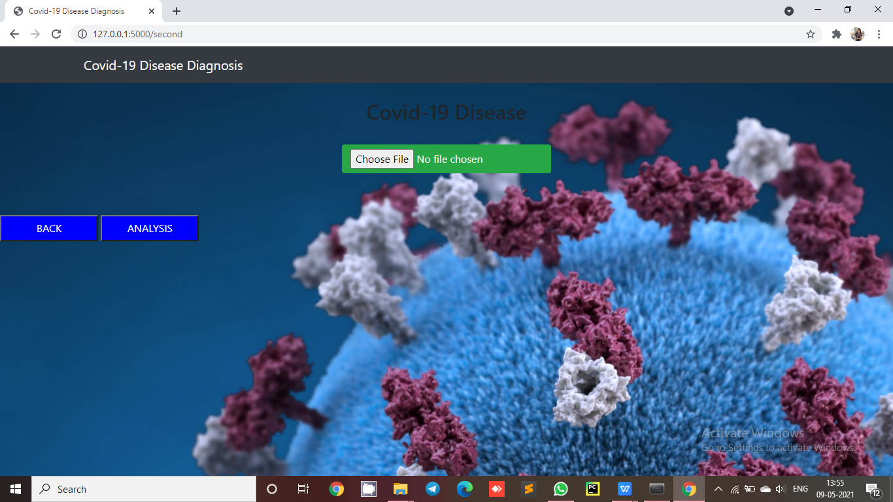
Chest CT-Scan
22

Slide 23
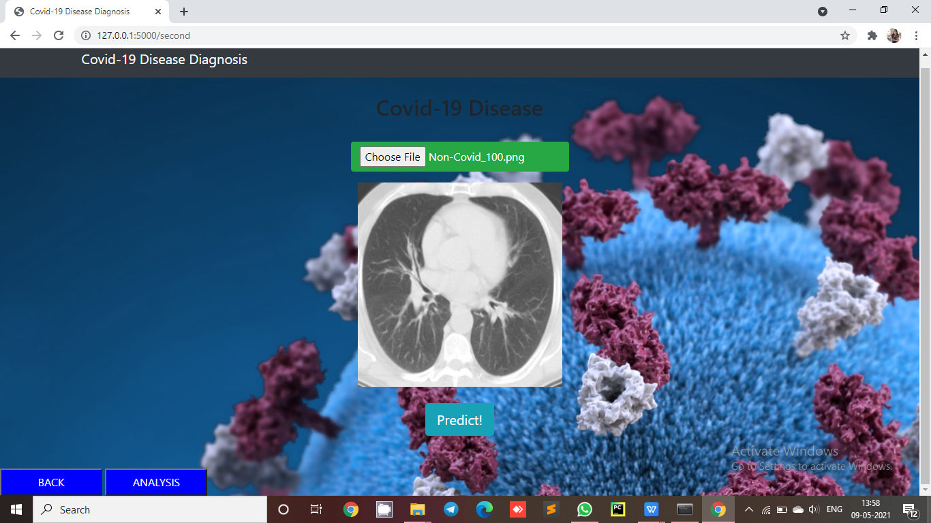
CT-Scan Report
23

Slide 24

CT -scan Report
24

Slide 25
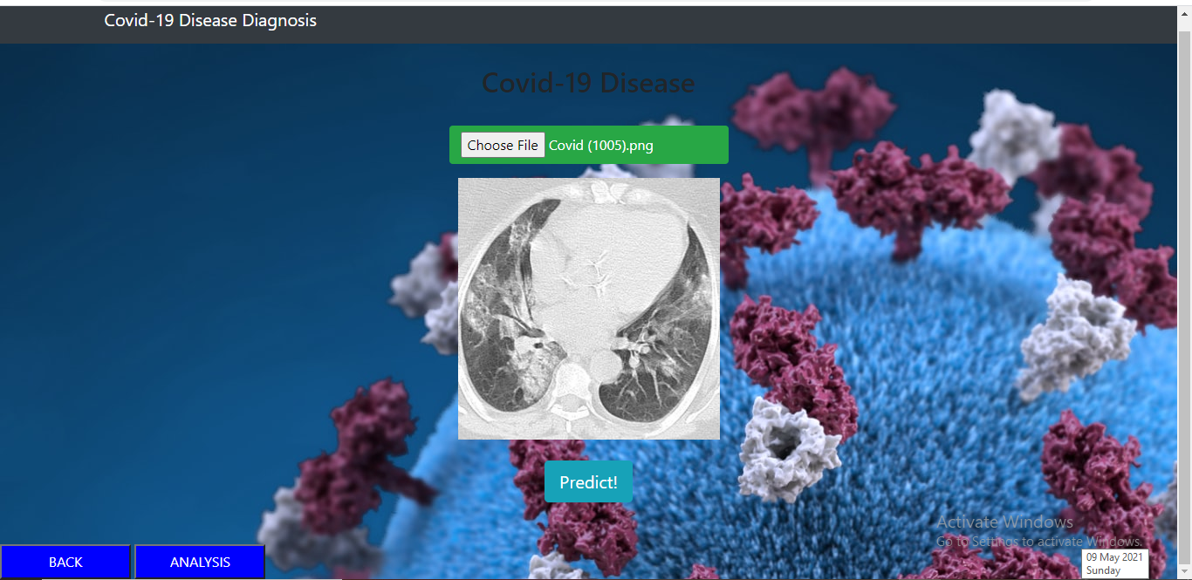
Check CT-Scan
25

Slide 26
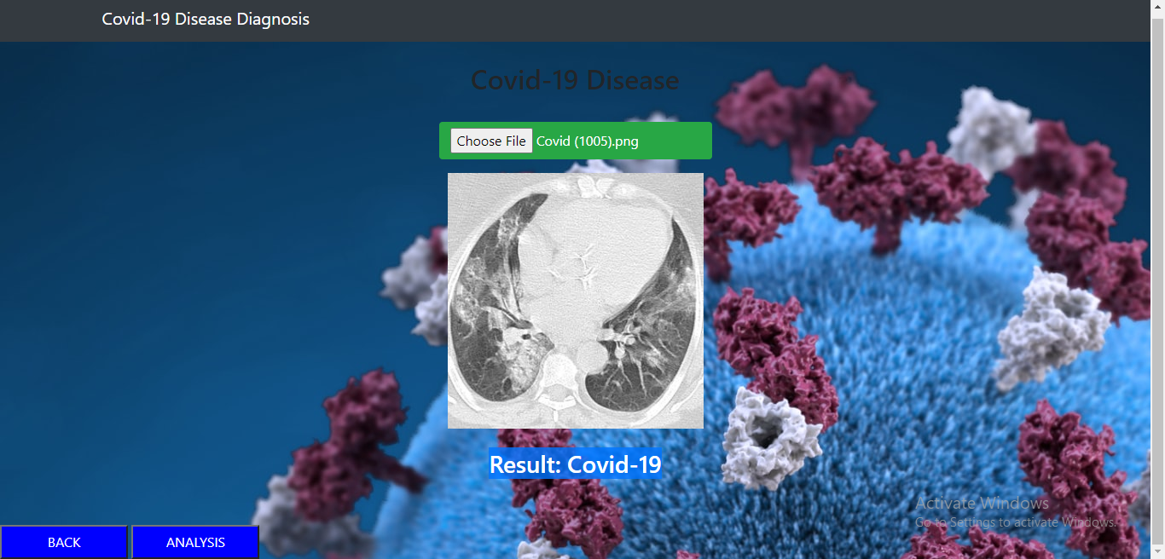
CT -scan Covid positive Report
26

Slide 27
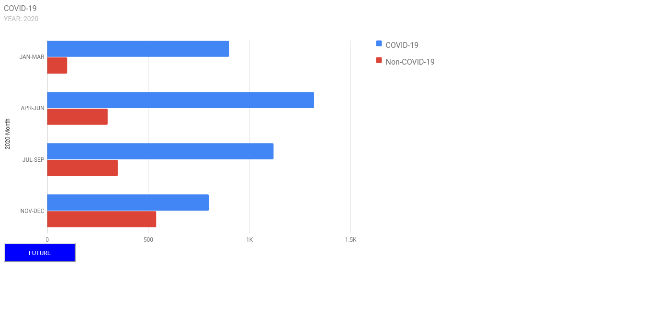
Analysis
27

Slide 28
CONCLUSION
28
This project demonstrated that a deep transfer learning is feasible to detect COVID-19 disease automatically from chest X-ray or CT-scan by training the learning model with chest X-ray and CT images mixed with COVID-19 patients, which may help doctors more effectively make their clinical decisions.
This project also gives an insight to how transfer learning was used to automatically detect the COVID-19 disease.
Due to current pndemic situation, this system can be widely used for detecting covid patient as early as possible.It can be used by any users, radiologists where has its need .

Slide 29
FUTURE SCOPE
29
Right now we are using only image data (i.e., X-rays and CT) —so in future it should leverage multiple data sources not limited to just images, including patient vitals, population density etc. Image data by itself is typically not sufficient for these types of applications.
we will need more data at various stages, with the COVID-19 X-rays taken when the patients present several symptoms.
I will try to add some more images for MRI etc to detect COVID desease.
I will try to improve the Accuracy using different model like HSGO model(Hybrid-Social-Group-Optimization-algorithm),Inceptionv3, DenseNet121 etc.
I will try to show the accuracy and effected part of chest also.

Slide 30
REFERENCES
30
“Artificial Intelligence and COVID-19: Deep Learning Approaches for Diagnosis and Treatment”,Mohammad Jamshidi,Ali Lalbakhsh,Jakub Talla,Zdeněk Peroutka,Luigi La Spada,School of Engineering and the Built Environment, Edinburgh Napier University, Edinburgh, U.K.
C. Huang et al., "Clinical features of patients infected with 2019 novel coronavirus in Wuhan China", THE LANCET, vol. 395, pp. 497-506, 2020.
N. Chen, M. Zhou, X. Dong, J. Qu, F. Gong, Y. Han, et al., "Epidemiological and clinical characteristics of 99 cases of 2019 novel coronavirus pneumonia in Wuhan China: A descriptive study", Lancet, vol. 395, no. 10223, pp. 507-513, Feb. 2020
D. Wang, B. Hu, C. Hu, F. Zhu, X. Liu, J. Zhang, et al., "Clinical characteristics of 138 hospitalized patients with 2019 novel coronavirus–infected pneumonia in Wuhan China", Jama, vol. 323, no. 11, pp. 1061-1069, 2020.
K. Liu, Y.-Y. Fang, Y. Deng, W. Liu, M.-F. Wang, J.-P. Ma, et al., "Clinical characteristics of novel coronavirus cases in tertiary hospitals in Hubei province", Chin. Med. J., vol. 133, no. 9, pp. 1025-1031, May 2020.

Slide 31
31
THANK YOU……....

